Slide 1
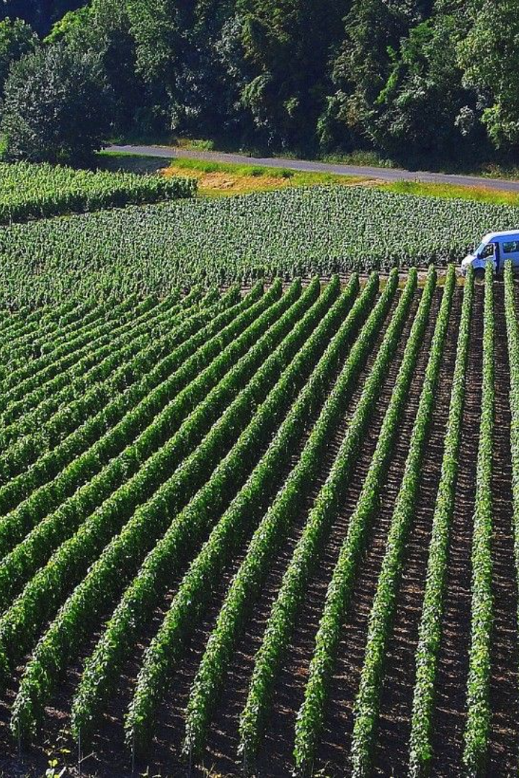
Smart Crop Protection System from Animals using PIC
By Team Number: 30 -Aniket Gund (Team Leader) -Prajwal Shahane -Urvi Patil

Slide 2

Abstract
Crops confront considerable damage from local animals, causing significant financial losses for farmers. To address this issue, we propose an automatic crop protection system leveraging the PIC microcontroller. The integration of PIR and Sound sensors enables the detection of obstacles, providing rapid alerts to farmers. Enhancing field security, the GSM module offers real-time location updates to guardians. To ensure reliable performance, a regulated power supply transforms the current into a stable 5V DC operation. This comprehensive system aims to mitigate losses, protect crops, and empower farmers with timely information for effective field management.

Slide 3

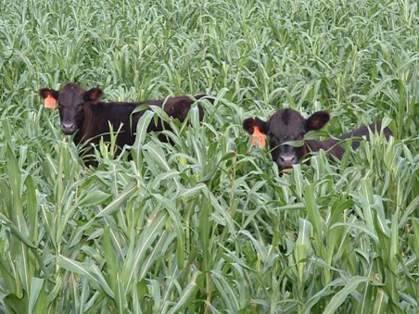
Aim & Objectives
Aim: Develop a PIC-based system for crop protection.
2
Objectives:
1
Protect Crops:
Assist farmers in safeguarding crops from wild animals and fire incidents using PIR sensor technology.
Enhance Crop Safety:
Develop a robust system prioritizing the well-being of cultivated plants against potential threats posed by wild animals.
Real-time Alerts:
Implement an efficient real-time alert mechanism for immediate notifications to farmers upon PIR sensor detection of animal activity.
Reduce Yield Losses:
Minimize crop yield losses caused by wild animals, addressing financial challenges farmers face due to crop damage.

Slide 4
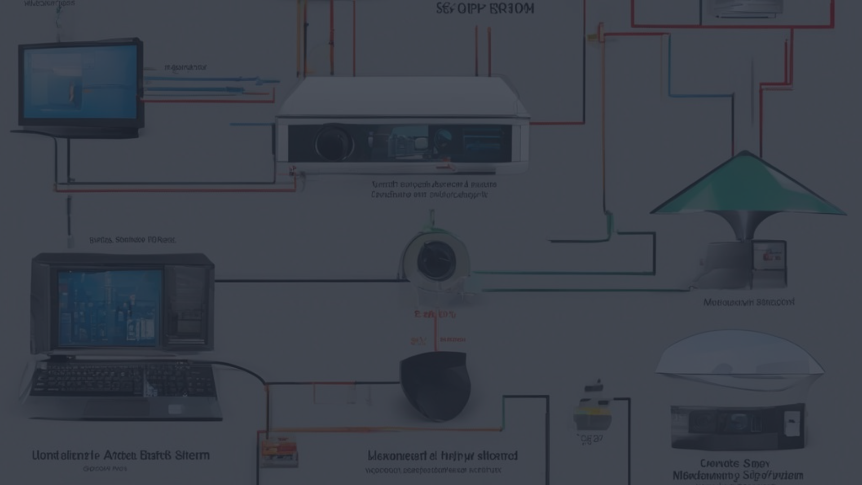
Literature Survey - Home Security
Sneha Nahatkar et al. [1] - Low-Cost Home Security System:
Proposes a low-cost security system using a small PIR sensor integrated with a microcontroller.
PIR sensor detects individuals not in thermal equilibrium, triggering an alarm and GSM module for alerting.
MCU activates a web camera to capture images for later analysis.
M. Sathish kumar et al. [2] - Embedded Surveillance System:
Presents an embedded surveillance system with GSM module and PIR sensor for warm body detection.
Triggers an alarm and sends SMS when detecting intruders; activates CCTV camera for real-time monitoring.
Suitable for home surveillance with low computational requirements.

Slide 5
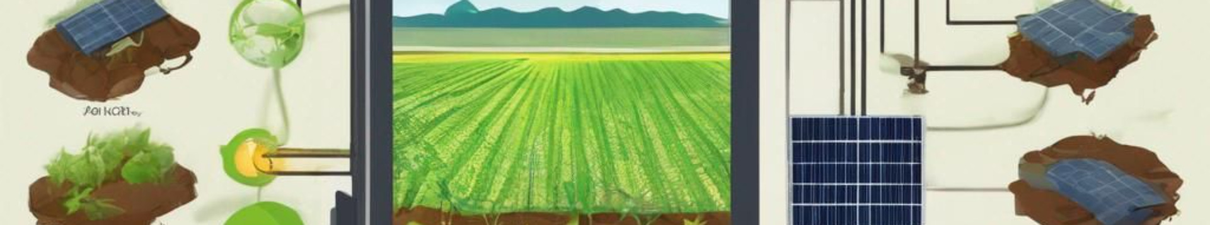
Literature Survey - Agriculture Monitoring
T. Gayathri et al. [3] - Continuous Crop Monitoring System:
Proposes a system for continuous crop monitoring, addressing challenges faced by farmers.
Utilizes two LDR sensors for solar radiation and leaf area index measurement with a PIC microcontroller.
Integrates a soil moisture sensor to monitor moisture levels, activating a DC motor when needed.
Sends real-time information to farmers via GSM and displays on an LCD screen, easing the cultivation process.

Slide 6

Motivation
Challenges Faced by Farmers:
Farmers grapple with multifaceted challenges such as diseases, pests, and adverse weather, yet one often overlooked issue is the significant crop damage caused by wild animals like deer, wild boars, and elephants. This challenge carries substantial financial implications due to yield losses and additional problems provoked by such incidents. It underscores the need for a cautious approach to crop protection, recognizing wild animals as living beings deserving of protection from potential sufferings. Addressing this aspect can contribute significantly to the overall well-being of farmers and sustainable agriculture.

Slide 7

Future Scope
1
Wireless Sensor Networks:
Integrate advanced wireless sensor networks for real-time data on crop conditions.
Enable global accessibility, allowing farmers to monitor fields from anywhere.
2
Image Processing for Animal Detection:
Explore image processing for precise wild animal detection.
Enhance the alert system with automated corrective actions.
3
Advanced Alert Mechanisms:
Investigate sophisticated alert mechanisms beyond SMS.
Consider mobile apps or web interfaces for seamless communication.
4
Collaborative Farming Platforms:
Develop platforms for collaborative farming, fostering shared insights.
Enable community-driven approaches for collective farming success.

Slide 8
Construction & Working
Crop-Damaging Animals:
Identify wildlife threats: wild pigs, deer, wild dogs, bison, nilgais, estray animals, and birds causing significant crop damage.
Impact on Yield and Finances:
Emphasize adverse effects: poor yields, substantial financial losses, and potential abandonment of fields due to frequent animal attacks.
System Objective:
Dual purpose: Keep animals away through automated solutions, saving time and preventing crop losses without manual intervention.
Motion-Detecting Sensor:
Core technology: Motion-detecting sensors for crop monitoring in diverse agricultural environments.
GSM Technology Alerts:
Immediate alerts: GSM technology sends SMS notifications on threats like fire outbreaks for real-time action.
Buzzer Sound Alert:
Local alarming: Buzzer sound alerts nearby people, stressing timely actions to diminish potential crop losses.

Slide 9
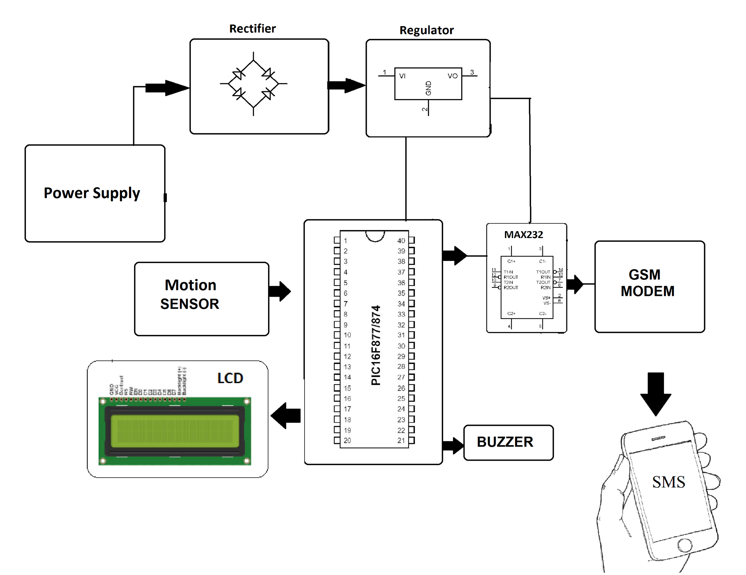
Block Diagram
Visualize key components: sensors, PIC microcontroller, communication module, and protective measures.

Slide 10
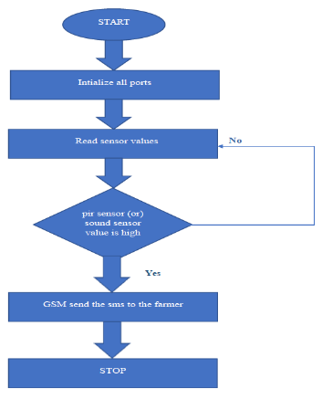
Flowchart

Slide 11
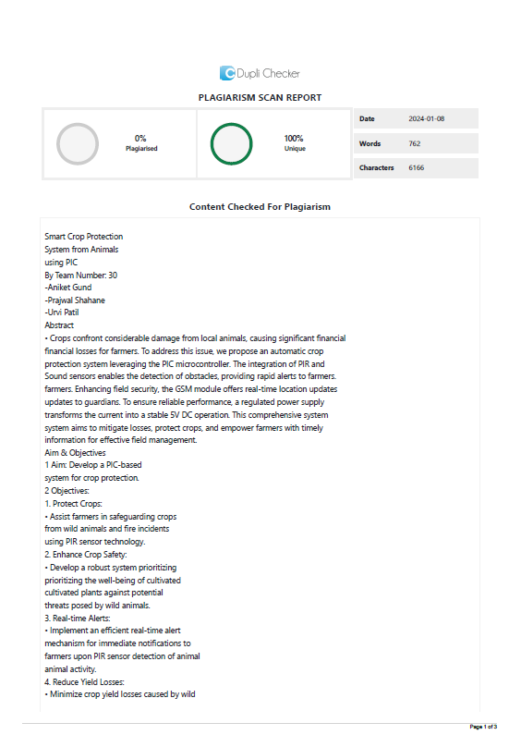
Plagiarism Report :

Slide 12
References:
No. | Reference Links for Research Papers
1 | https://www.irjet.net/archives/V7/i3/IRJET-V7I31048.pdf
2 | https://ijlesjournal.org/2021/volume-4%20issue-4/ijles-v4i4p101.pdf
3 | https://www.ijcrt.org/papers/IJCRTO020033.pdf
4 | https://www.academia.edu/44885381/Smart_Crop_Protection_System_from_Animals_using_PIC
5 | https://ieeexplore.ieee.org/document/10181093

Slide 13

Thank You !!!

